Slide 1
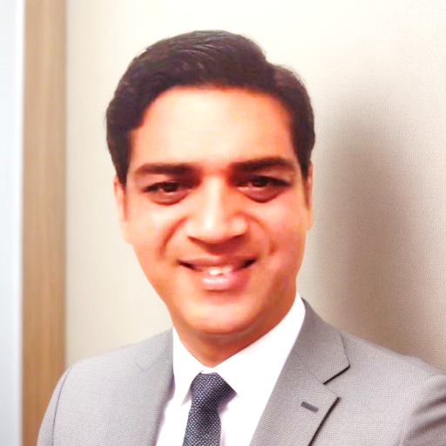

Praveen Parimi
Senior Business Analysis &
Process Optimization Professional
15+ Years of Expertise in Business Analysis, Product Management, and Process Optimization
Contact Details
:praveenba3@gmail.com
☎: +91 9121680907
: https://www.linkedin.com/in/praveenparimi/

Slide 2
Career Overview
20+ Years’ Experience | 15+ Years in Business Analysis & Process Optimization | Fortune 100 Clients (Nationwide, AT&T)
15 years as a Business Process Consultant, Business Architect, and Business Analyst, successfully navigating complex projects across insurance, telecom, fintech, and startups.
Expertise in Business Analysis, Product Management, Business Architecture, Project Management, Solution Architecture, and Data Architecture. Also, expert in AI/ML-driven process mining proofs-of-concept and predictive analytics.
Proven leadership in both Agile and Waterfall environments, utilizing methodologies such as Waterfall, RUP, Agile, and XP to drive successful project outcomes.
Key Skills & Specializations:
Business Process Mapping & Gap Analysis: Strong expertise in documenting ‘as-is’ and ‘to-be’ processes to optimize workflows and increase operational efficiency.
Requirements Gathering & Documentation: Experience in creating essential project documentation like: Business Requirements Documents (BRD), System Requirements Specifications (SRS), Functional Requirements Document (FRD), Non-Functional Requirements (NFR) and Use Case Document (UCD).
Collaboration & Leadership: Skilled at conducting Joint Requirement Planning (JRP), Joint Application Development (JAD), and Joint Application Review (JAR) sessions with stakeholders, SMEs, development, and QA teams.

Slide 3






Notable Tools & Technologies:
Process Design & Visualization: UML, BPMN, Use Cases, User Stories to specify and visualize requirements.
Expertise in Blueworks Live, MS Visio, Adobe XD, iGrafx, iRise, Rational Suite, MS Project, Jira, and Confluence to streamline processes and enhance project management.
Proven Project Leadership:
Led projects in CRM system overhauls, End to End Architecture upgrades. Policy Administration Systems (PAS) transformations, and product development in startups, contributing to significant business growth and optimization.
Collaborating with Fortune 100 Companies and Career progression:
Extensive experience working with Fortune 100 companies like Nationwide Mutual Insurance and AT&T, delivering results-driven solutions and managing large-scale digital transformations, focusing on system integrations, business process optimization, and technology implementations.
Java Developer 2004 - 2007
Sr. Business Analyst/Team Lead 2011
Lead Business Analyst/Product Mgr 2012
Lead Business Analyst/Product Manager 2016
Lead Business Analyst/Product Manager 2017
Sr Business Analyst/Business Process Consultant 2019
Lead Business Analyst 2024-Continued
System Analyst 2010

Slide 4
Key Projects – Responsibilities, Achievements & Outcomes
Berry Ads & Branding | Agile Transformation & Product Development
Project Description: As the Lead Business Analyst, I was responsible for transforming the product development process in a startup environment by implementing Agile methodologies.
Role: Recruited and mentored Business Analysts and UX designers, managed team structure and Agile adoption, and implemented a scalable product development lifecycle aligned with client needs.
Challenges: Built Agile teams from the ground up, ensuring alignment with evolving client priorities and establishing a sustainable delivery pipeline.
Achievements: Increased delivery speed by 30% through Agile practices while delivering high-value, customer-centric product features.
Outcome: Successfully launched multiple features ahead of schedule, improving customer engagement and client satisfaction.
Importance: Demonstrated ability to drive business impact in a lean startup setting through structured Agile delivery and cross-functional team leadership.

Slide 5
Nationwide Mutual Insurance | CRM & BPM Modernization and Process Optimization Projects
Project Description: Led end-to-end modernization of legacy CRM systems through process mining, data migration, and BPMN-based reengineering.
Role: As the lead on requirements and system design, I designed and piloted AI/ML-driven process-mining proofs-of-concept using Blueworks Live and Visio; led migration from seven legacy systems into IBM BPM/MDM.
Challenges: Managed complex system integration of legacy platforms with new CRM technologies while maintaining seamless data migration and system compatibility.
Achievements: Reduced workflow cycle-time by 40%, improved data accuracy, and simplified CRM workflows using As-Is/To-Be process design.
Outcome: The project significantly reduced operational costs by 7% and improved customer service response times by 20% through automation and enhanced data accuracy.
Importance: This overhaul enhanced Nationwide’s customer support capabilities, positioning the CRM system as a critical component for better customer engagement and operational efficiency.

Slide 6
AAA Insurance | Policy Administration System (PAS) Transformation and Process Optimization Projects
Project Description: Spearheaded the transformation of the Policy Administration System (PAS) to improve member experience, streamline workflows, and scale transactions from $2.5B to $10B over seven years.
Role: As the business analyst lead, Led requirement gathering and UI/UX design sessions using iGrafx and Adobe XD.
Challenges: Coordinated across multiple IT and business units to address vendor solution design inconsistencies, manage IT development, and implement feature-driven iterative processes.
Achievements: Improved delivery speed by 20% and achieved 7% cost savings by retiring redundant systems and introducing scalable workflows.
Outcome: Achieved a 30% improvement in transaction processing times and scaled the system to support $10B in transactions, leading to improved customer support and operational efficiency.
Importance: This transformation was crucial for AAA’s growth, enabling faster processing and positioning the company to handle significantly increased transaction volumes.

Slide 7
AT&T | Mobile App Readiness & Predictive Analytics
Project Description: As the Lead Business Systems Analyst, I worked on AT&T’s first mobile app ecosystem, enhancing monitoring, escalation, and outage response through system readiness automation.
Role: Gathered detailed requirements for app performance tracking and escalation rules, worked with cross-functional teams to define triggers and metrics, and created system flow diagrams in MS Visio.
Challenges: Coordinated between marketing, operations, and development to standardize response logic for multiple apps under a unified platform, ensuring timely fault identification.
Achievements: Defined requirements for anomaly-detection models based on historical performance logs, enabling early outage detection and reducing downtime by 20%.
Outcome: Delivered a fully defined and approved requirements set for predictive outage management, which improved response time and system uptime.
Importance: Reinforced AT&T’s digital readiness by enabling proactive, data-driven alerting systems in a complex, multi-app environment.

Slide 8
BUSINESS PROCESS OPTIMIZATION
Overview
Optimized workflows across Insurance, Finance, and Telecom sectors to boost process efficiency and ROI.
Utilized tools like MS Visio, Blueworks Live, iGrafx, and BPMN modeling for comprehensive “as-is” and “to-be” process mapping.
Delivered measurable results for clients such as Nationwide Mutual Insurance, AAA, AT&T, and Apollo Education Group.
Examples of Impact
AAA -Policy System Optimization: Transitioned from Waterfall to Agile and redesigned PAS workflows using iGrafx and Adobe XD, improving delivery speed by 20% and reducing operational costs by 7%.
Nationwide Mutual Insurance - CRM and BPM System Upgrade: Led AI/ML-driven process-mining POCs using Blueworks Live and BPMN, reducing cycle-time by 40% and improving customer service response by 20%.
Startup (Current Role) - Process Automation: Established Agile delivery in a startup setting, recruiting BAs and UX designers, and implementing a product lifecycle that improved delivery speed by 30% and increased client satisfaction.

Slide 10
Stakeholder Collaboration
Engaging Stakeholders for Project Success
Description: I’ve consistently prioritized collaboration with stakeholders, including business leaders, technical teams, operations, marketing, and end-users, to ensure projects align with business goals and are executed seamlessly. My ability to communicate complex requirements in a clear, accessible manner has been vital to project success enabling reduced rework, accelerated delivery, and increased adoption.
Responsibilities & Examples of Collaboration
Stakeholder Liaison:
Example: As the primary liaison at Nationwide Mutual Insurance and AT&T, I bridged the gap between business and technical teams across various departments, including marketing, product, and IT. By listening to both sides, I captured input, minimized gaps, and ensured alignment between requirements, technical feasibility, and delivery timelines.
Outcome: This approach minimized misunderstandings and helped projects stay on schedule with clear, approved requirements.

Slide 11
Leading Joint Application Development (JAD) Sessions:
I organized and led JAD sessions to bring together subject matter experts, development teams, and QA specialists, especially at Nationwide and AAA Insurance. These sessions allowed real-time feedback and ensured that our solutions aligned perfectly with business needs.
Example: I organized and led JAD sessions to bring together subject matter experts, business leads, and QA specialists—especially at Nationwide and AAA Insurance. These sessions allowed real-time feedback and ensured that our solutions aligned precisely with business needs.
Tools Used: I utilized RRC for centralized documentation, making it easy for stakeholders to access all project information, and RTC to manage tasks and track updates following each session.
Translating Requirements into Actionable Documents:
I translated high-level business requirements into system requirements and functional specifications, ensuring everyone understood project expectations.
Example: At AAA, I developed Functional Requirements Documents (FRD), created Use Case Descriptions, and mapped out system workflows, which served as critical resources for development teams.
Outcome: This detailed documentation provided clarity, reduced scope creep, and ensured all requirements were covered, saving significant development time.

Slide 12
Wireframing and Mockups:
I created wireframes and mockups to give stakeholders a visual understanding of system features, interfaces, and workflows before development.
Example: I created interactive wireframes and mockups to align stakeholder expectations and provide early visual feedback. These were particularly effective for PAS (AAA) and CRM (Nationwide) redesigns.
Additional Tools Used: Adobe XD, Pencil, and iRise for collaborative UI design and interactive mockups.
Significance of Stakeholder Collaboration
Purpose: My collaboration approach actively aligns stakeholder expectations with project outcomes. By involving stakeholders throughout design and delivery (including retrospectives), I ensure projects are delivered on time, within scope, and with minimal friction.
Impact: At Berry Ads & Branding, Nationwide and AAA, my contribution to collaboration and facilitation delivered tangible results: reduced response times, lower rework, and accelerated feature rollouts by 20–30%.

Slide 13
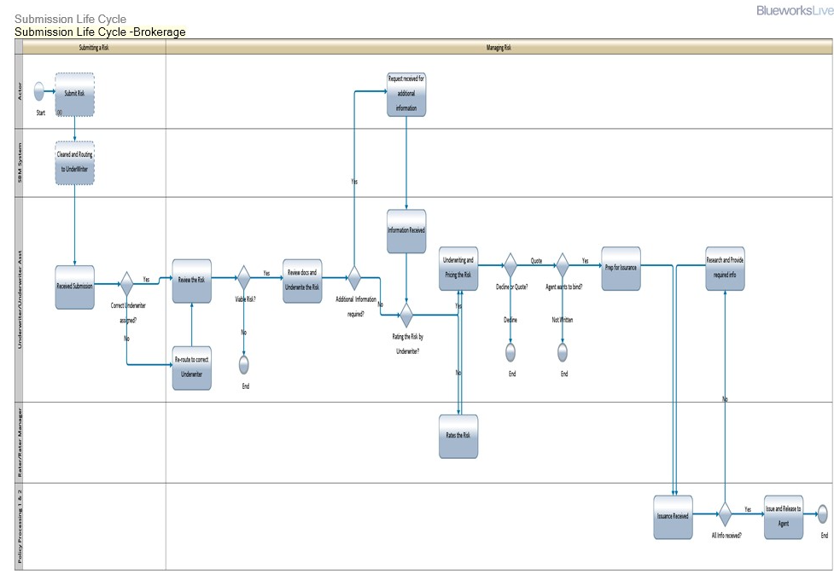
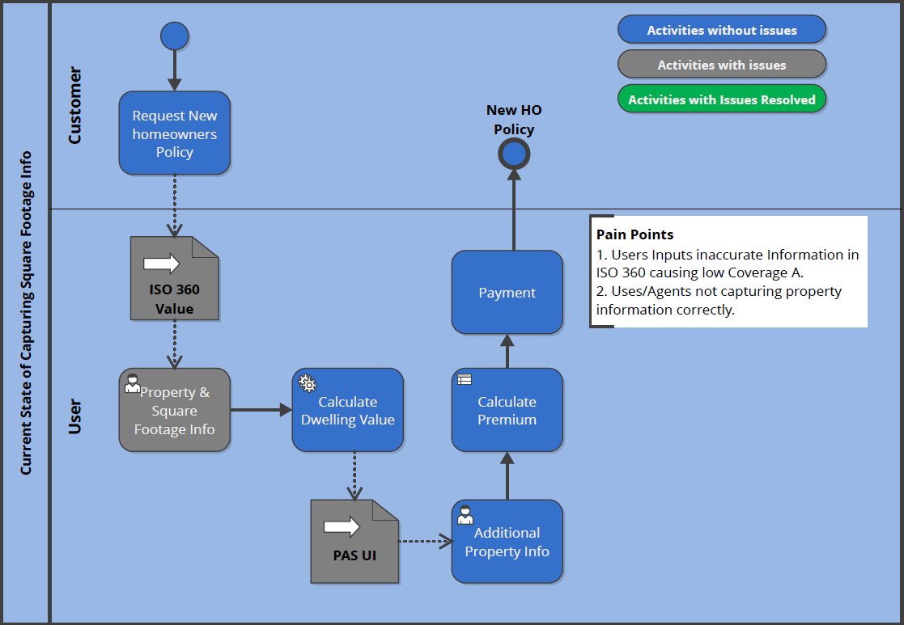
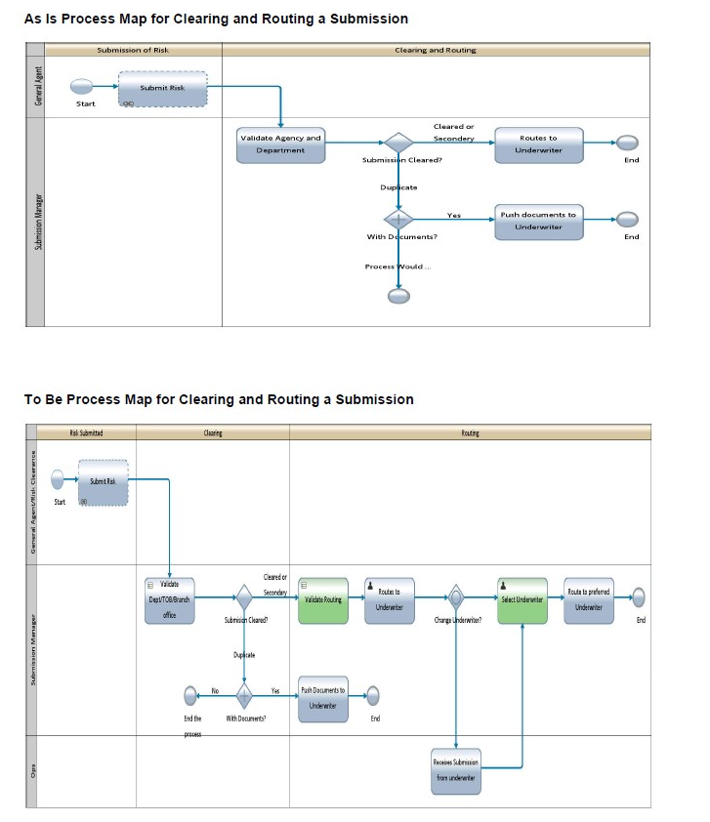
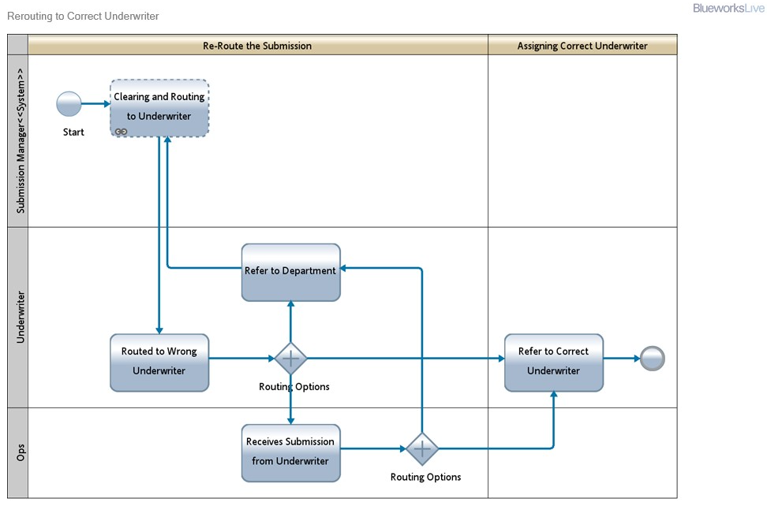
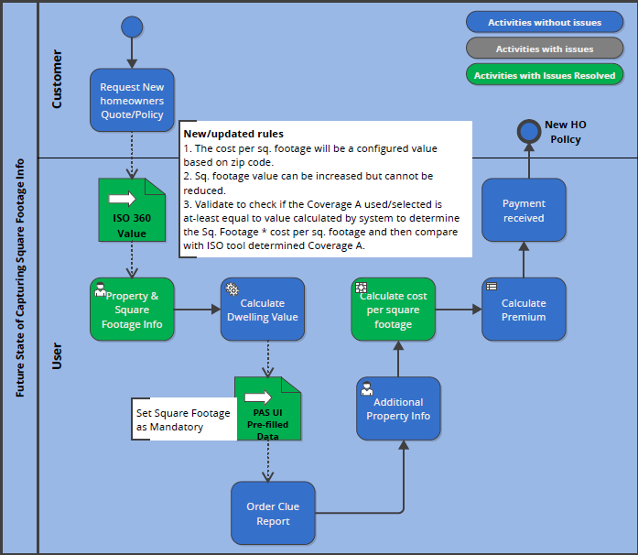
Design Artifacts
Process Maps

Slide 14
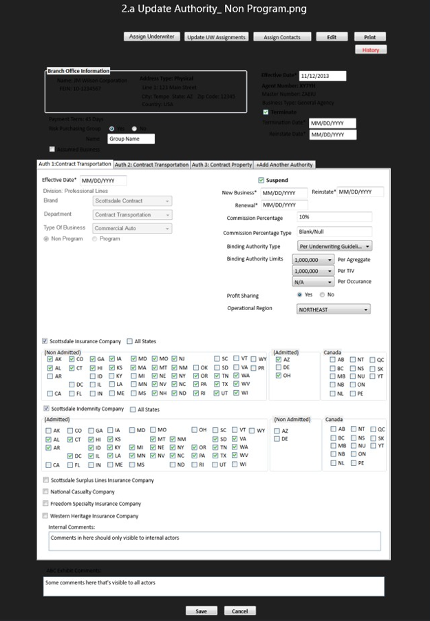
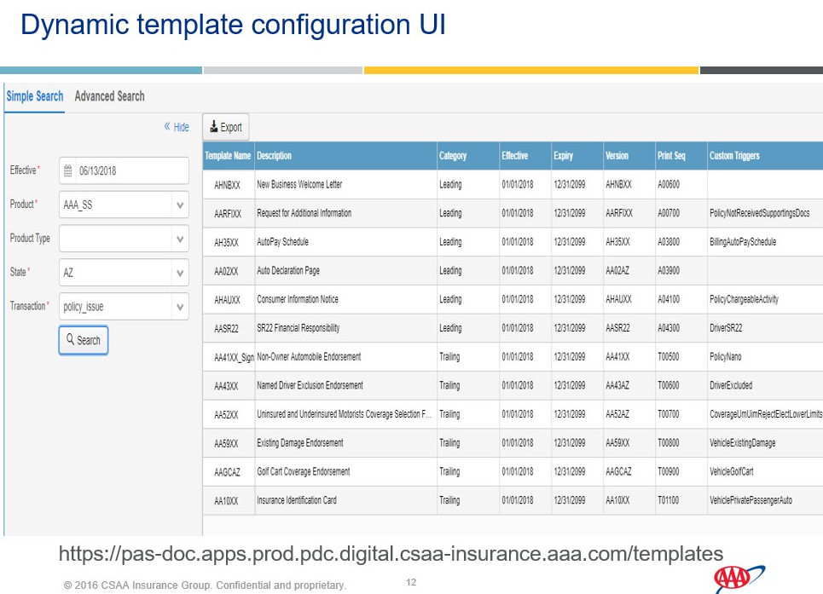
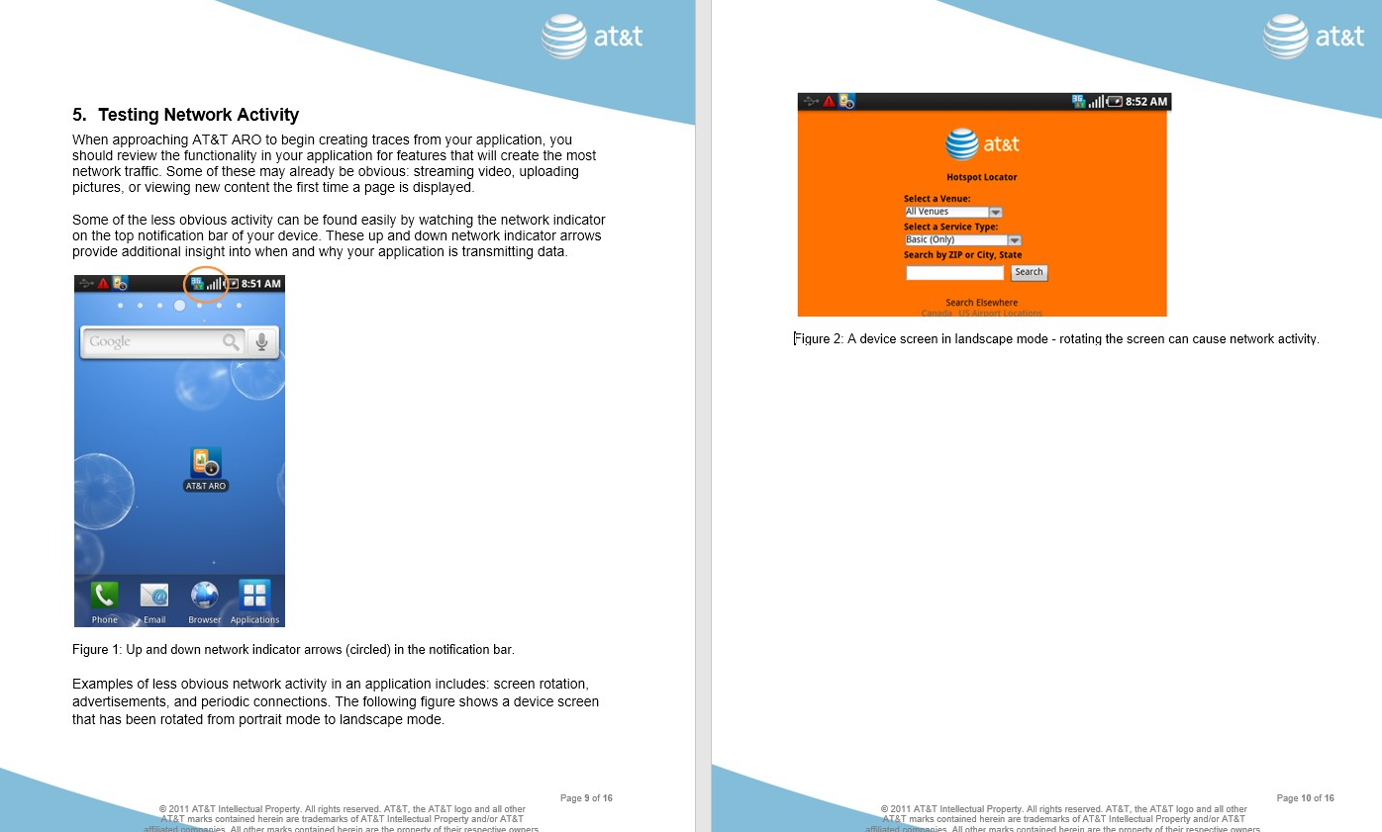
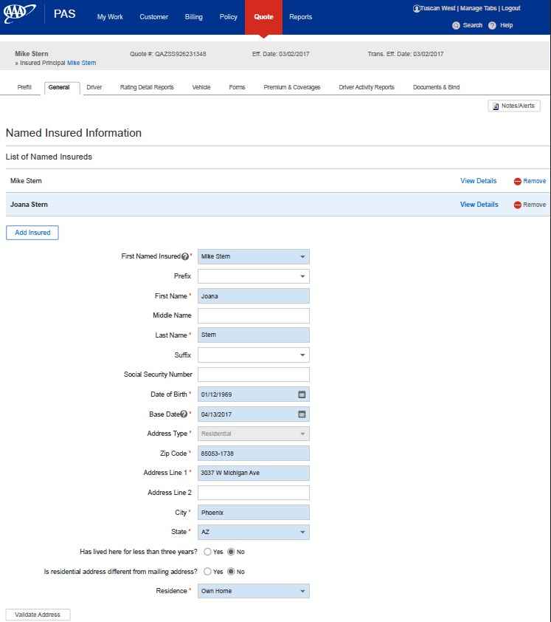
Mockups & Wireframes:

Slide 15
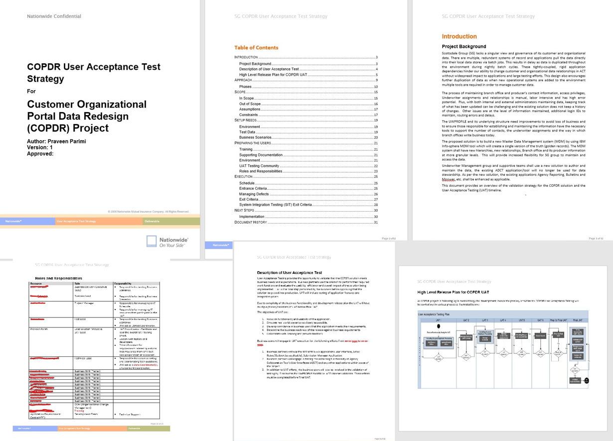
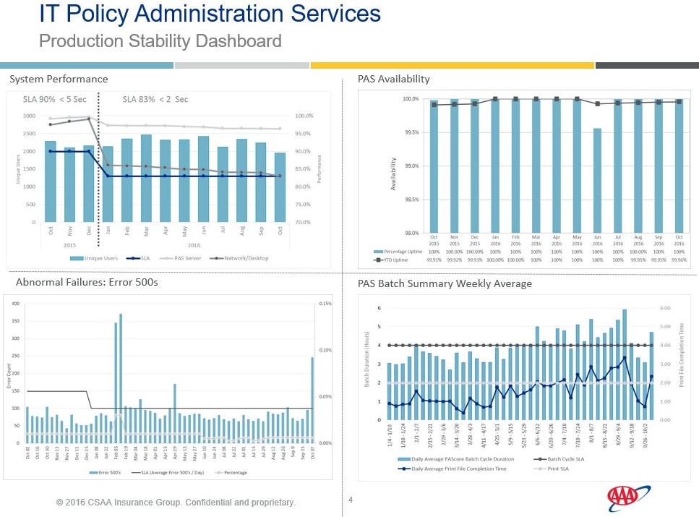
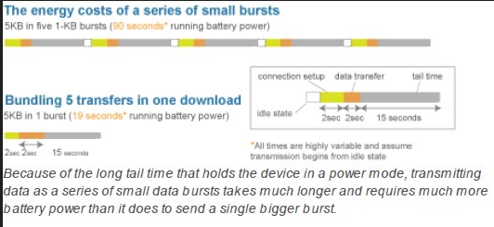
Key Documentation:
Functional Specifications Document
Click here to Open FRD
User Stories
Click here to Open User Stories
User Acceptance Testing
Process Statistics

Slide 16
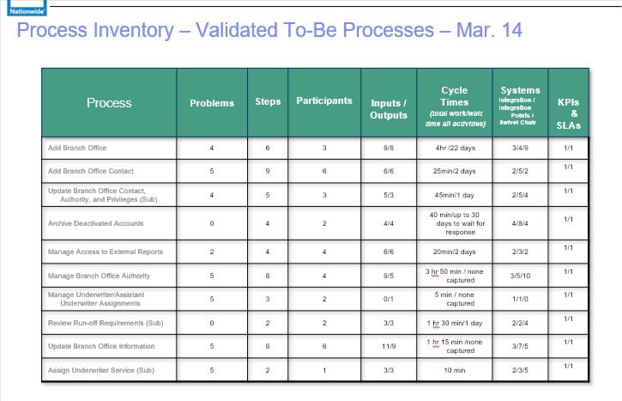
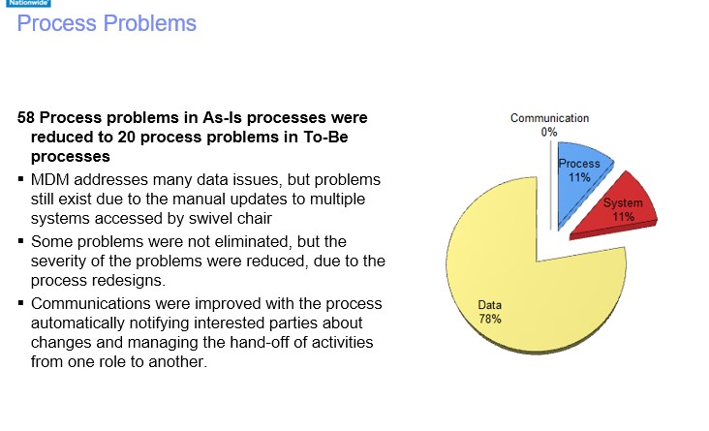
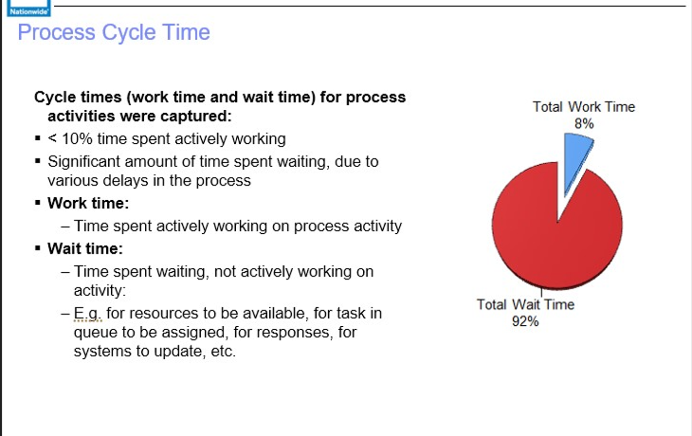
“This presentation includes selected artifacts, such as mockups, process flow diagrams, and documentation samples. These artifacts are curated to illustrate my professional methodology while safeguarding proprietary information. Certain labels and specific project details have been intentionally omitted to prevent disclosure of confidential data and to focus solely on demonstrating my approach and expertise.”

Slide 17
Entrepreneurial Experience in Startups
My Role and Achievements at Berry Ads & Branding
Role in Building from Scratch: At Berry Ads & Branding, I led Agile transformation efforts by creating delivery processes from the ground up. I structured the product development lifecycle to address startup challenges and scale efficiently.
Responsibility: Recruited and mentored Business Analysts and UX Designers, established Agile teams, defined sprint cadences, and implemented structured feedback loops to align delivery with client needs.
Outcome: Achieved a 30% increase in delivery speed and successfully launched multiple product features ahead of schedule, resulting in improved customer satisfaction.
Key Innovation in Resource Constraints: Guided prioritization of feature sets and technical solutions to maximize ROI with limited resources, resulting in the creation of a lean product roadmap aligned with client needs.
Impact: Improved stakeholder engagement, enabled faster feature validation, and ensured consistent value delivery even with constrained budgets.
Scalable Growth Strategy: Introduced scalable Agile delivery systems that enabled the company to respond to market demand and support long-term, client-centered product development.

Slide 18
Impact on Business Growth:
The delivery foundation I implemented helped Berry Ads & Branding achieve early success and positioned the business for scalable, sustained growth—strengthening client relationships and market response.
Key Takeaways from Startup Experience:
This experience sharpened my entrepreneurial mindset—where agility, resourcefulness, and client-focused delivery were essential. I gained hands-on insight into building scalable systems and delivering value from the ground up—skills I bring to every organization I join.

Slide 19
Conclusion
Summary of My Professional Journey
With over two decades of years of experience in IT, my career reflects a blend of strategic analysis, Agile leadership, and transformation delivery across Fortune 100 clients and high-growth startups. I’ve successfully led enterprise process optimizations and AI/ML-driven digital transformations across industries.
Key Skills & Value-Add
Digital Transformation | Process Mining & Optimization | Agile Leadership
Stakeholder Collaboration | Cross-Functional Team Building | Scalable Product Delivery
Final Note: I’m passionate about helping teams unlock business value. Let’s connect to explore how my experience in transforming complex processes into streamlined, scalable solutions can support your organizational goals.

Slide 20
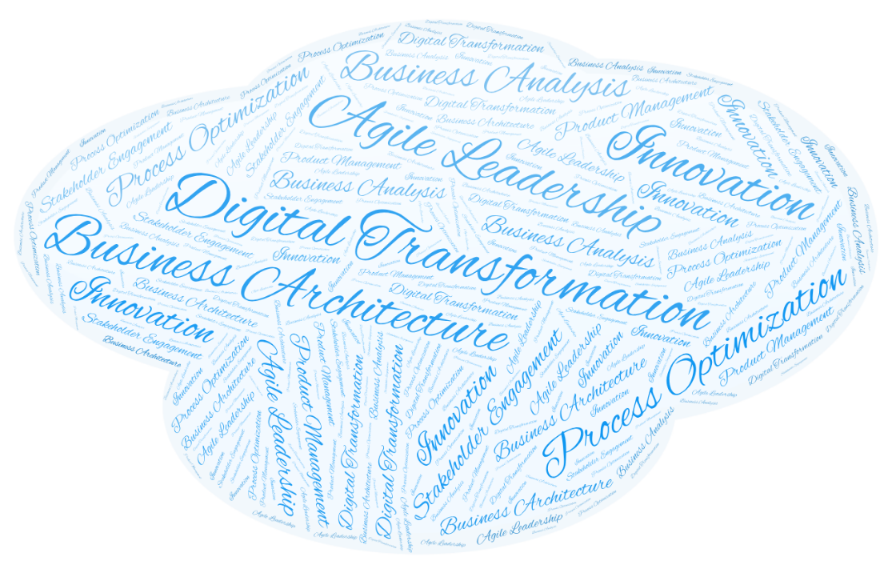
Thank You
Let’s connect and explore how my expertise can add value to your organization—feel free to reach out!
Contact Details
:praveenba3@gmail.com
☎: +91 9121680907
:https://www.linkedin.com/in/praveenparimi/

